Slide 1

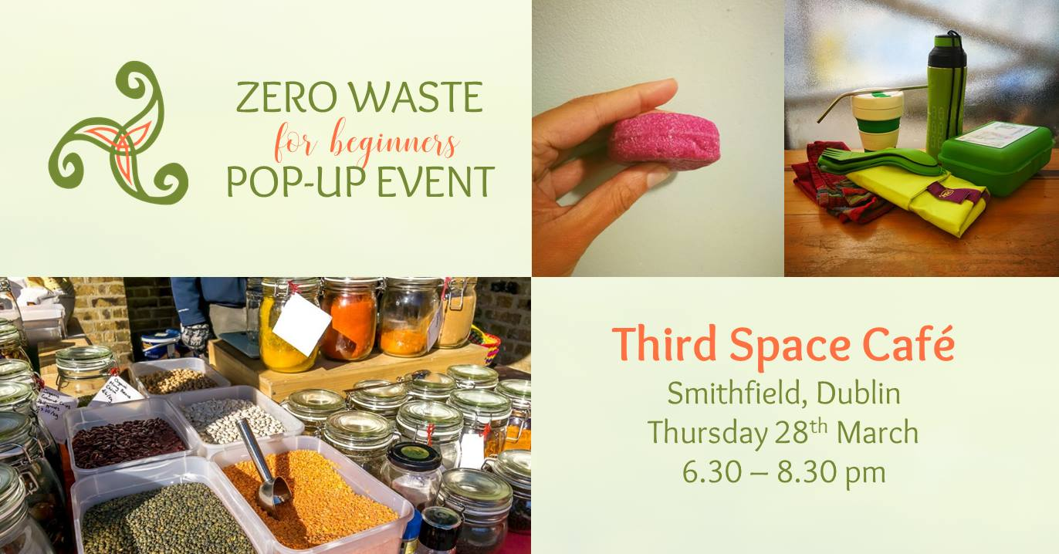


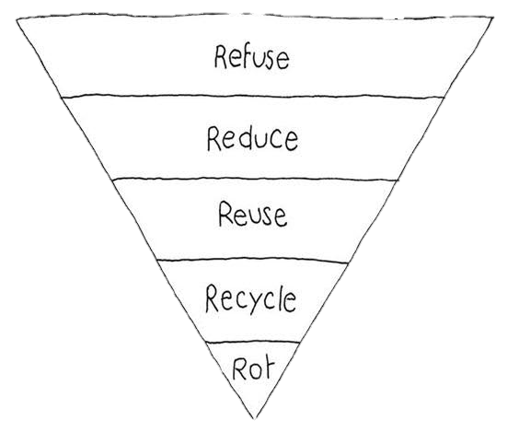


Slide 2




Slide 3
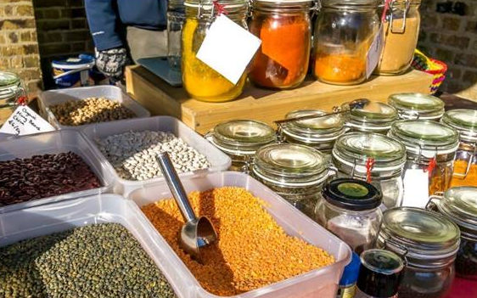

Slide 4


Slide 5

ZERO WASTE
POP-UP EVENT
Swap Shop
MVP Bar
29 Upper Clanbrassil St., D8
Tuesday, June 4, 2019
7:00 – 9:00 pm

Slide 6

ZERO WASTE
POP-UP EVENT
Cleaning Products
MVP Bar
29 Upper Clanbrassil St., D8
Tuesday, May 21, 2019
7:00 – 9:00 pm

Slide 7



